Slide 1



TOOLKIT
CASCADE TRAINING
Management of International Project
SOUPHANOUVONG UNIVERSITY
1st December 2021
By: Palitha DOUAGCHACK
E-mail: palitha_su@yahoo.com
SOUPHANOUVONG UNIVERSITY

Slide 2

Table of Contents
Project management definition
Project management cycle
Management phases
How to identify risks
Examples of risks management
SOUPHANOUVONG UNIVERSITY

Slide 3
Project Management in Simple Words
Problem solving
Teamwork
Communication
Project Management
Risk
Budget
Deadlines
Goals
Planning
SOUPHANOUVONG UNIVERSITY

Slide 4
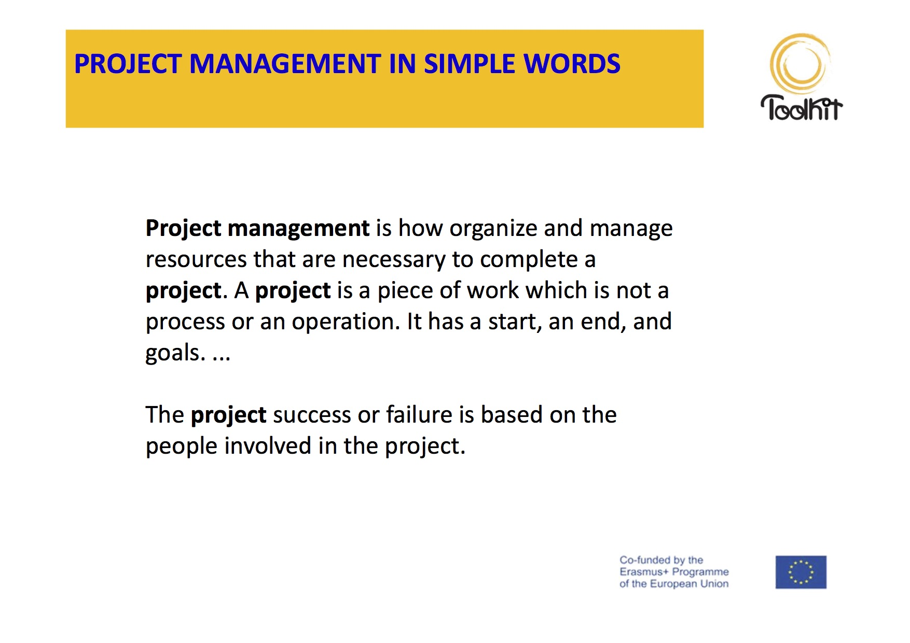
SOUPHANOUVONG UNIVERSITY
SOUPHANOUVONG UNIVERSITY

Slide 5
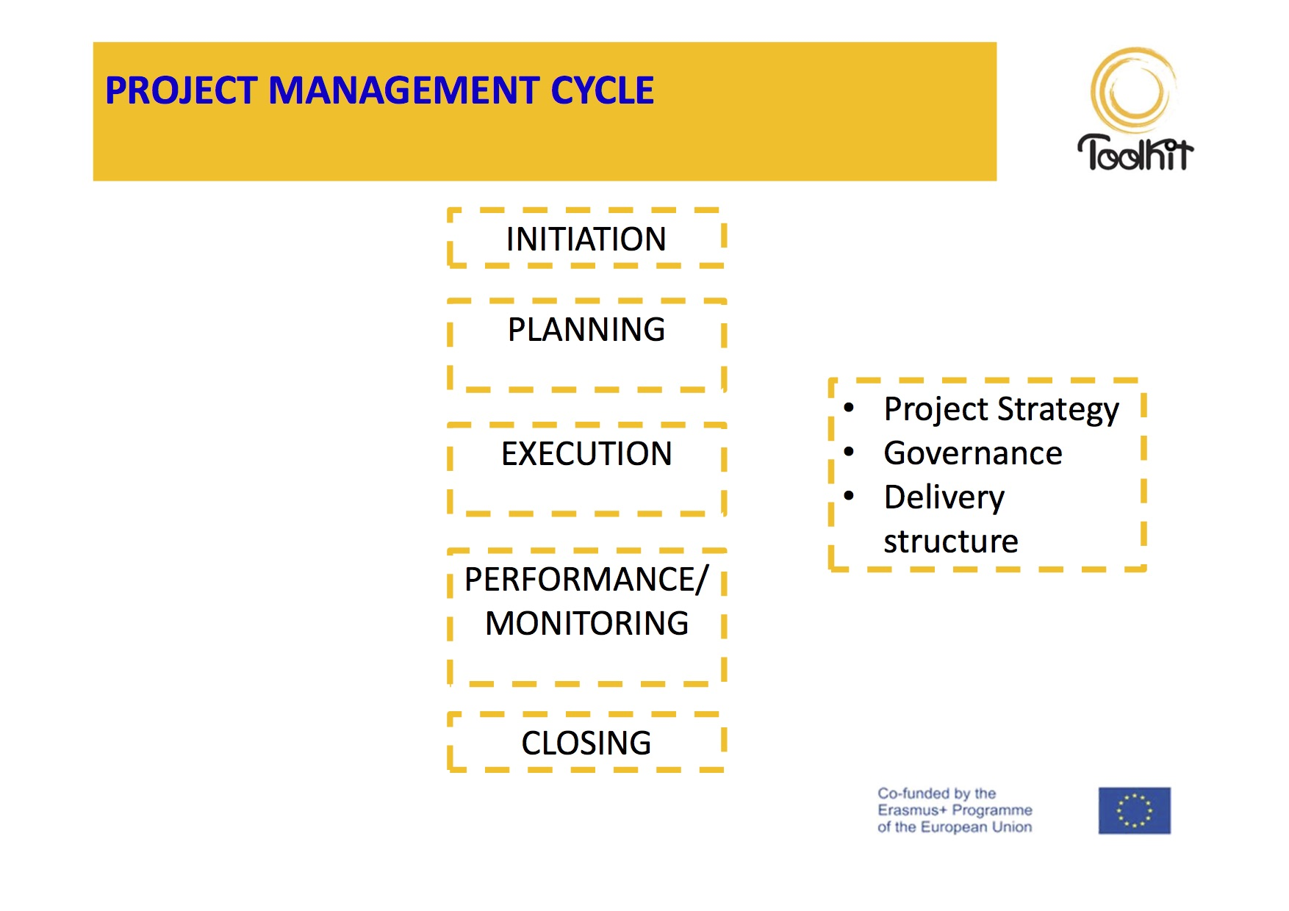
To Summarise
Who is eligible to apply?
Does the call for proposal require a minimum number of participants?
Can I propose my own project idea or do I have to stick to pre- identified thematic priorities?
Does the donor finance my activities at 100% or do I have to co-finance?
What are the award criteria?
Does the call fund conferences, meetings and creation of networks, pay for staff?
What are the eligible categories of costs?
SOUPHANOUVONG UNIVERSITY
SOUPHANOUVONG UNIVERSITY
Notes:
Monitoring: ກວດກາ, ກວດສອບ

Slide 6
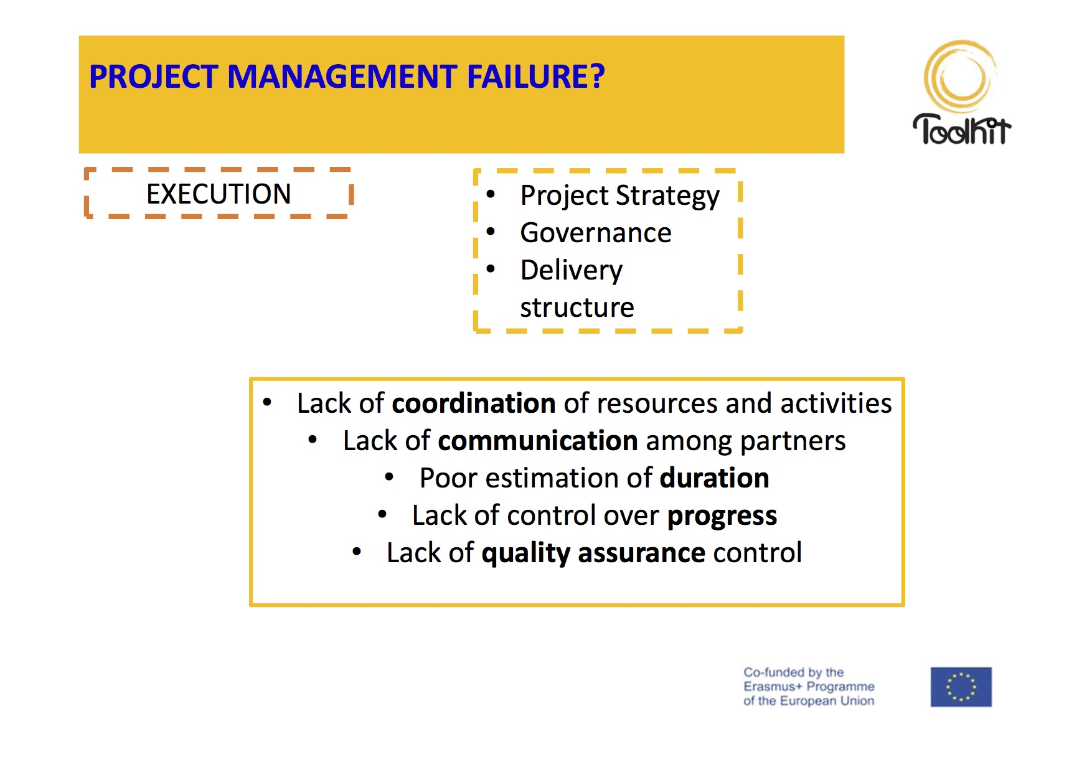
SOUPHANOUVONG UNIVERSITY

Slide 7
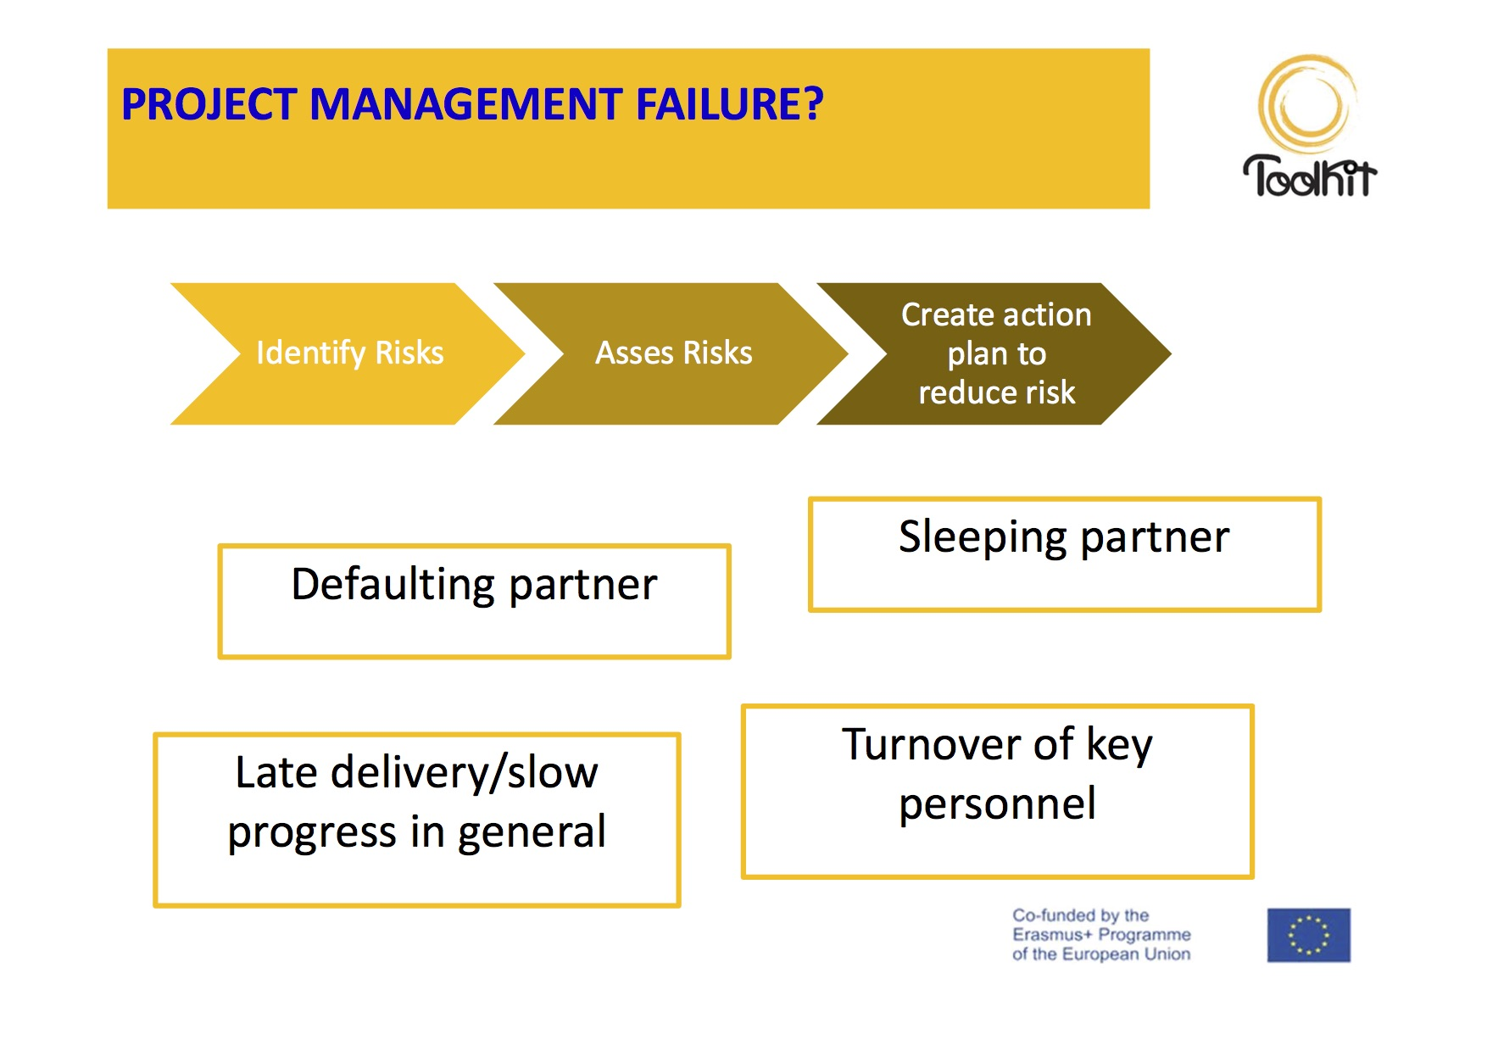
SOUPHANOUVONG UNIVERSITY

Slide 8
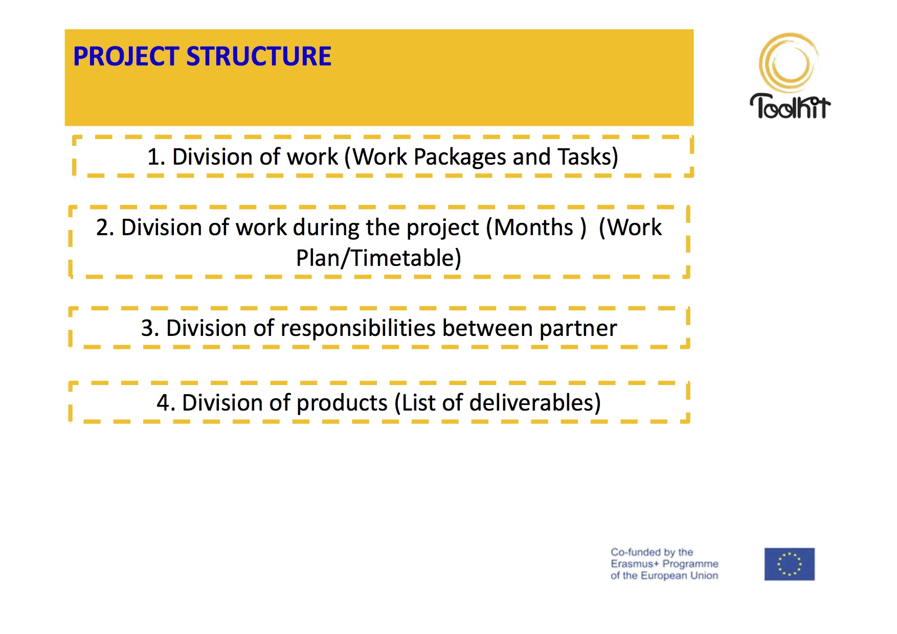
SOUPHANOUVONG UNIVERSITY

Slide 9
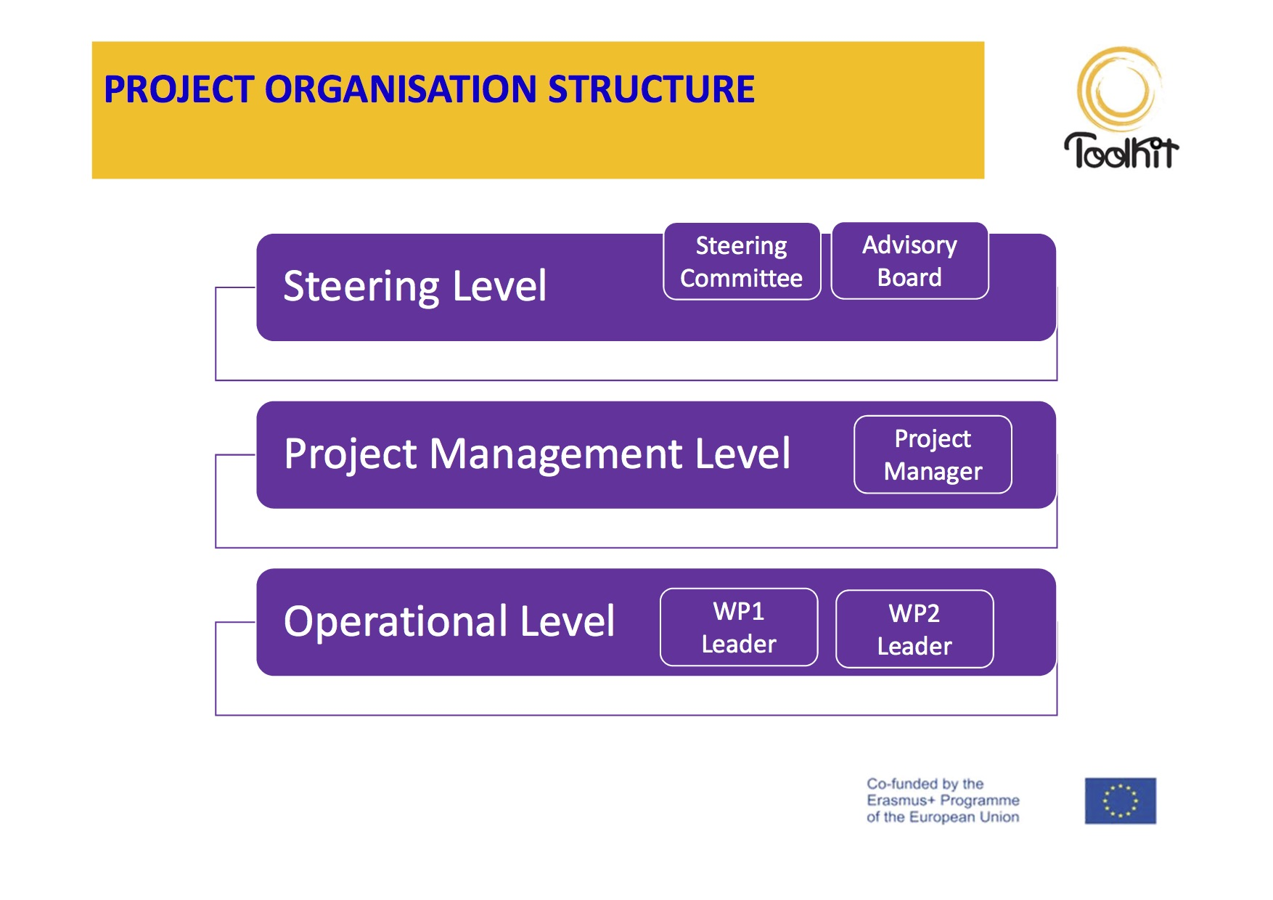
SOUPHANOUVONG UNIVERSITY

Slide 10
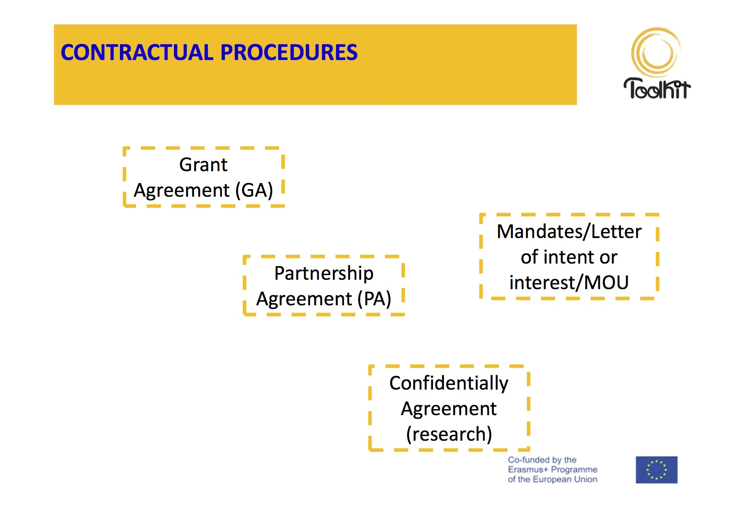
SOUPHANOUVONG UNIVERSITY

Slide 11
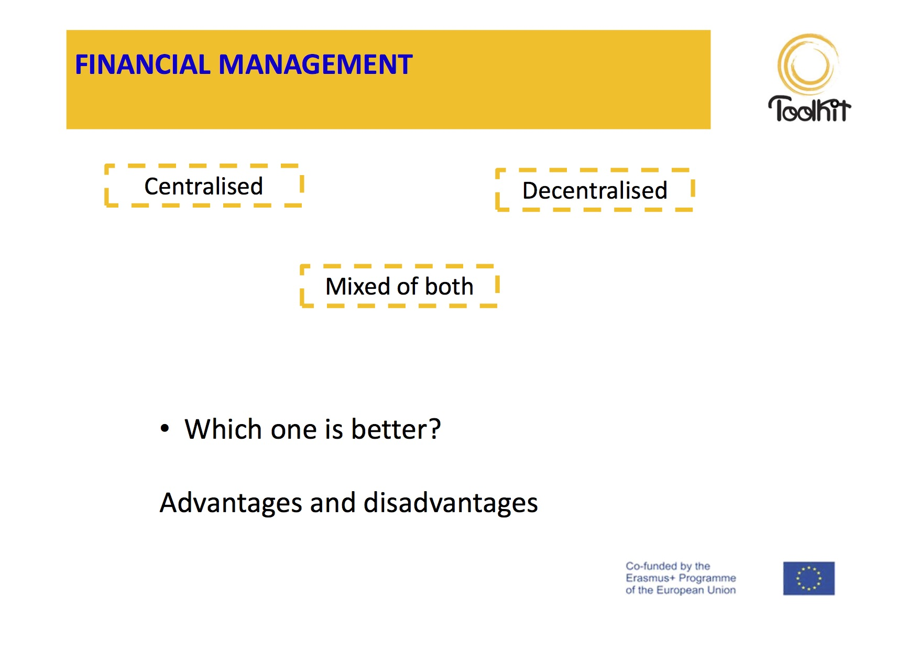
SOUPHANOUVONG UNIVERSITY

Slide 12
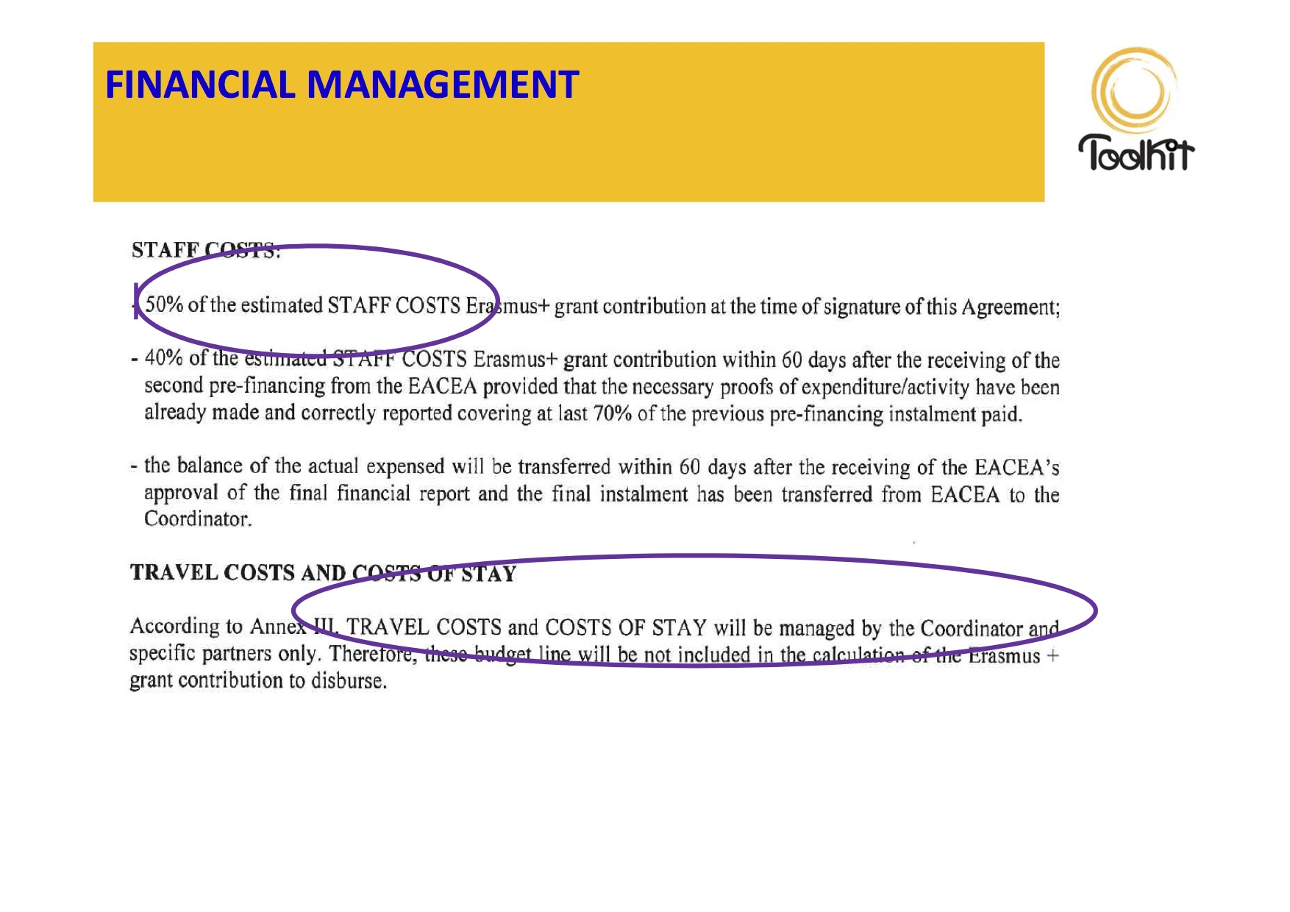
SOUPHANOUVONG UNIVERSITY

Slide 13
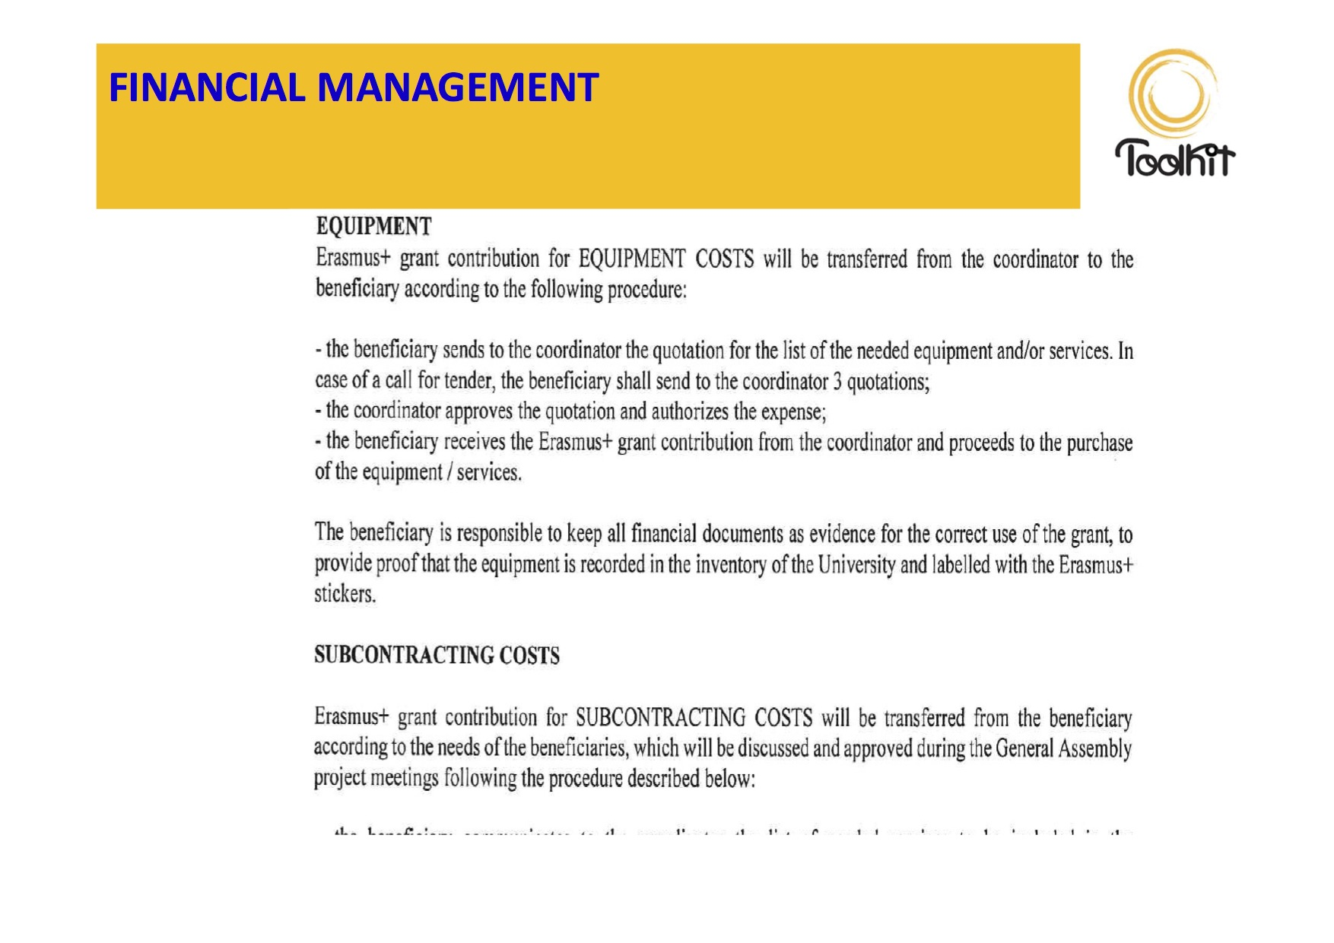
SOUPHANOUVONG UNIVERSITY

Slide 14
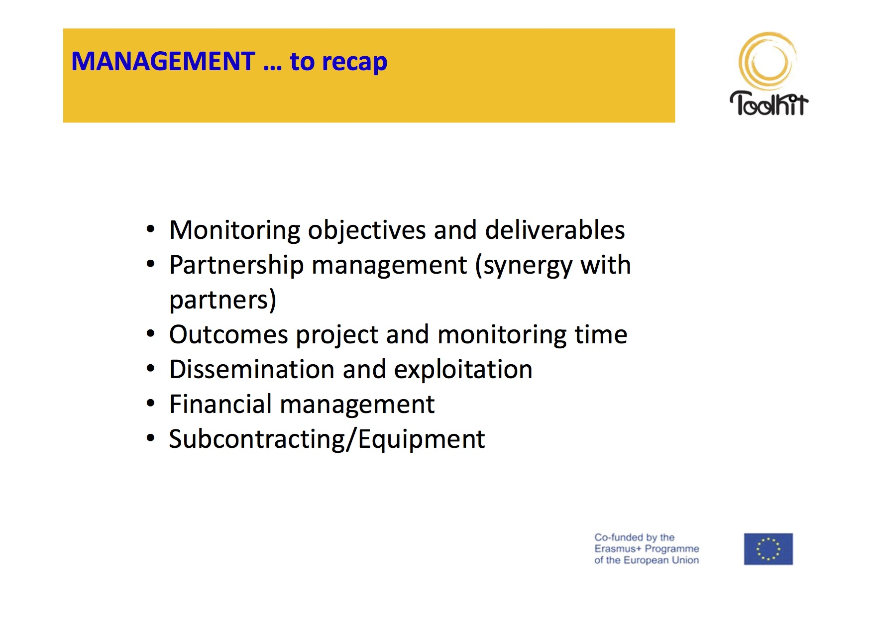
SOUPHANOUVONG UNIVERSITY

Slide 15
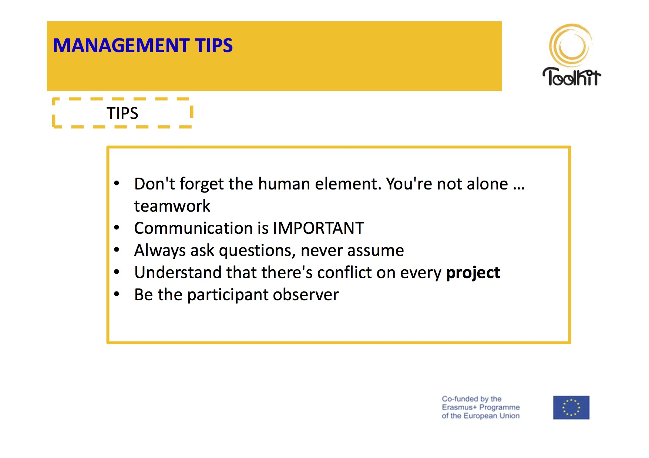
SOUPHANOUVONG UNIVERSITY

Slide 16
Souphanouvong University
Thank You for Your Attention
Any Questions?
SOUPHANOUVONG UNIVERSITY

